Slide 1
Interaction with CERN Open Data
A UX case study
Sebastian Feger

Slide 2
Outline
What is CERN Open Data (COD)?
Hands-on: Let’s have a look together
Target audience
COD is undergoing a revision
Why we are doing it
Dealing with our challenges
Mockup of the revised version
Next steps
How about you?

Slide 3
What is CERN Open Data (COD)?
Makes experiment data publicly available
Available tools allow to visualize analyses
Supports education and research efforts
Over 200k distinct page accesses per month

Slide 4
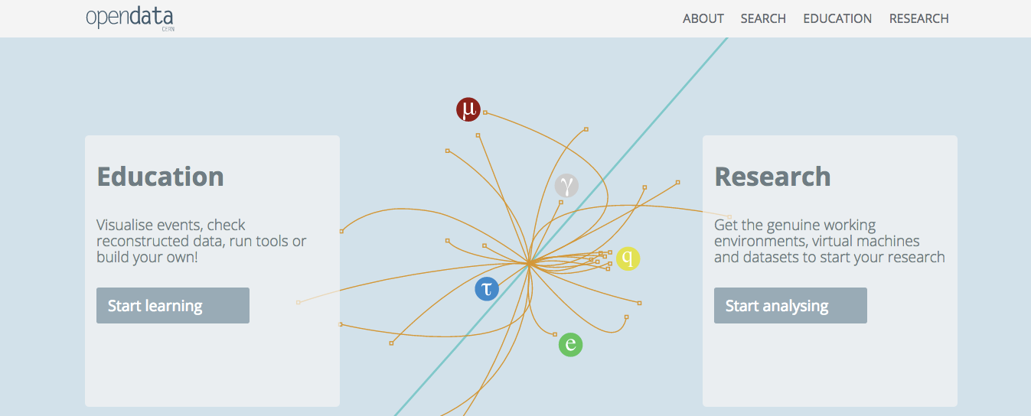
Hands-on: Let’s have a look together

Slide 5
Target audience
Your turn: What do you think?
Researchers
Educators
Students (High school / University)
Teachers
Professors
General public

Slide 6
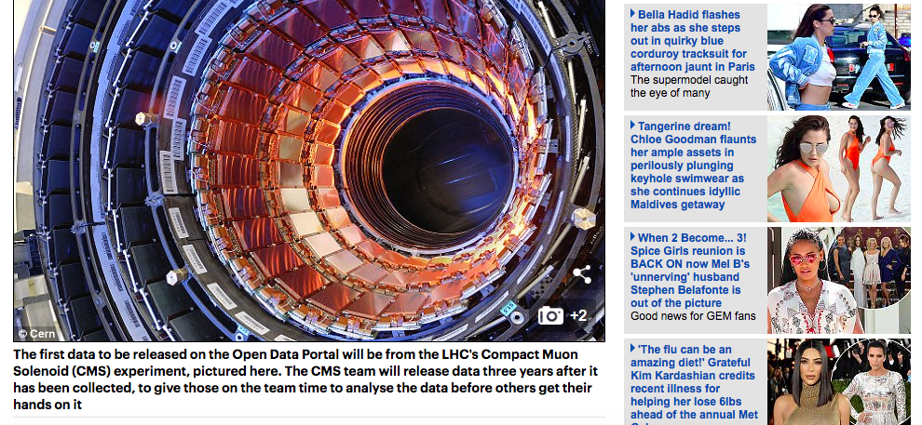
Target audience – We have to keep the general public in mind
Popular magazines often link to the COD portal
Daily Mail (UK)

Slide 7
COD is undergoing a revision
Your turn: Do you know what we don’t like about the current version?
Static
Requires decisions before showing contents
No contents for general public
Inefficient usage of screen space

Slide 8
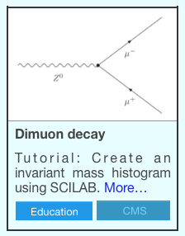
Dealing with our challenges
Walkthrough / News style showing various types of content and allowing for a well understood information interaction
Tag-based approach enabling dynamic experience

Slide 9
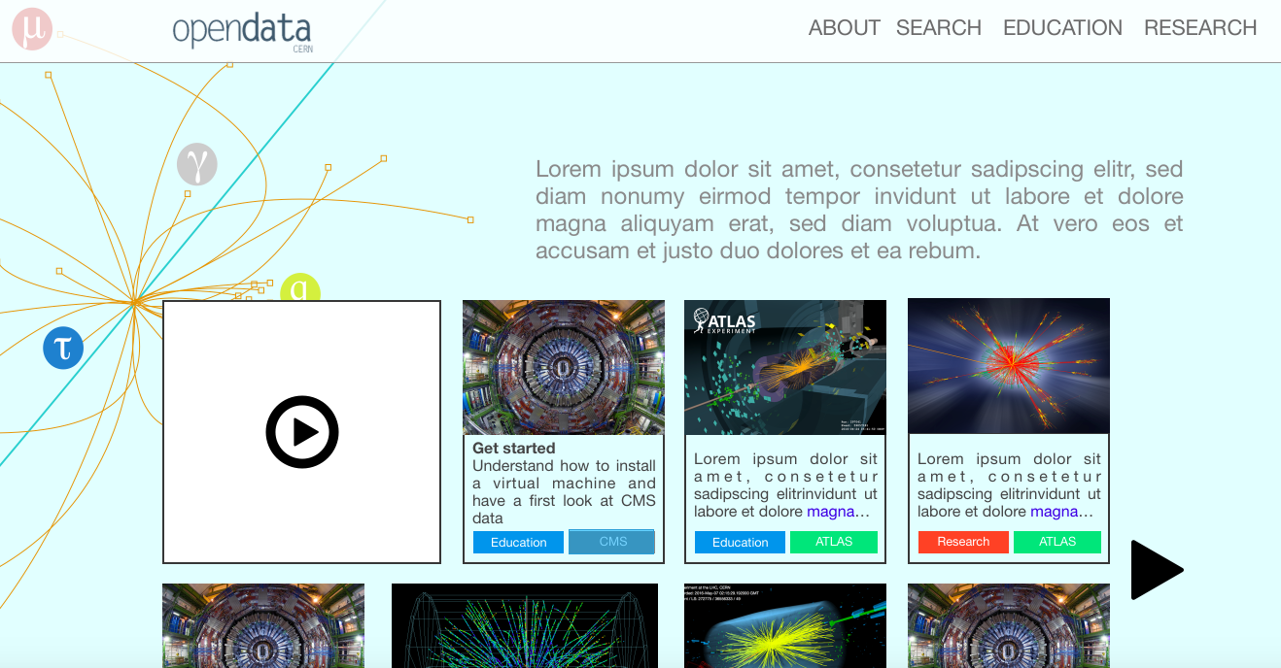
Mockup of the revised version

Slide 10
Next steps
Getting input from our target users
Defining the tags / tag hierarchy
Conducting usability tests

Slide 11
How about you?
Do you have any other comments / suggestions / ideas?

